Slide 1
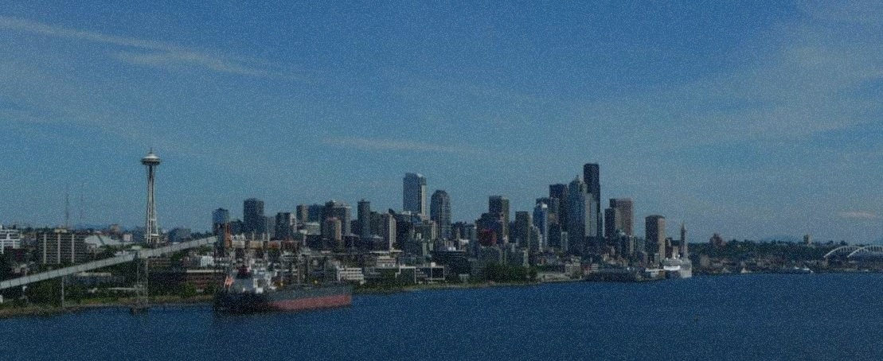
Seattle
Making the Most of Your First Port

Slide 2
Visit Seattle
Before or After
Your Cruise to Alaska!
Kodiak West Travel Can Help
You Develop Your Itinerary

Slide 3
Day One
Sample
Itinerary
Get an early start!
  Pike Place Market for breakfast and shopping
  Olympic Sculpture Park and a stroll along the waterfront
Mid-afternoon
  The Seattle Aquarium
Evening
  Seattle Underground Tour
  Pike Place Market for dinner

Slide 4
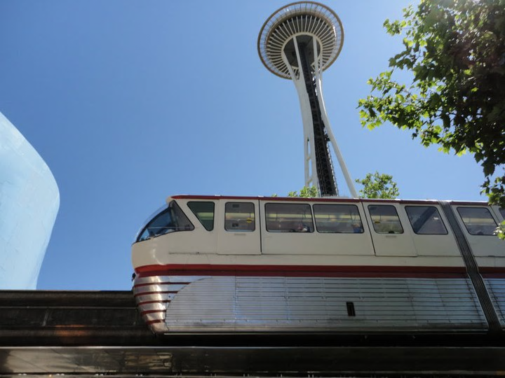
Day Two Sample Itinerary
Pike Place Market
  Breakfast here again and visit the places you loved or missed
Experience Music Project and Science Fiction Museum
The Space Needle
  Seattle’s iconic and most famous landmark

Slide 5

Although cruises to Alaska are held during summer months, a visit to Seattle in summer is no guarantee of sunshine! Keep your favorite umbrella handy!

Slide 6
And if you can spare
one more day…

Slide 7
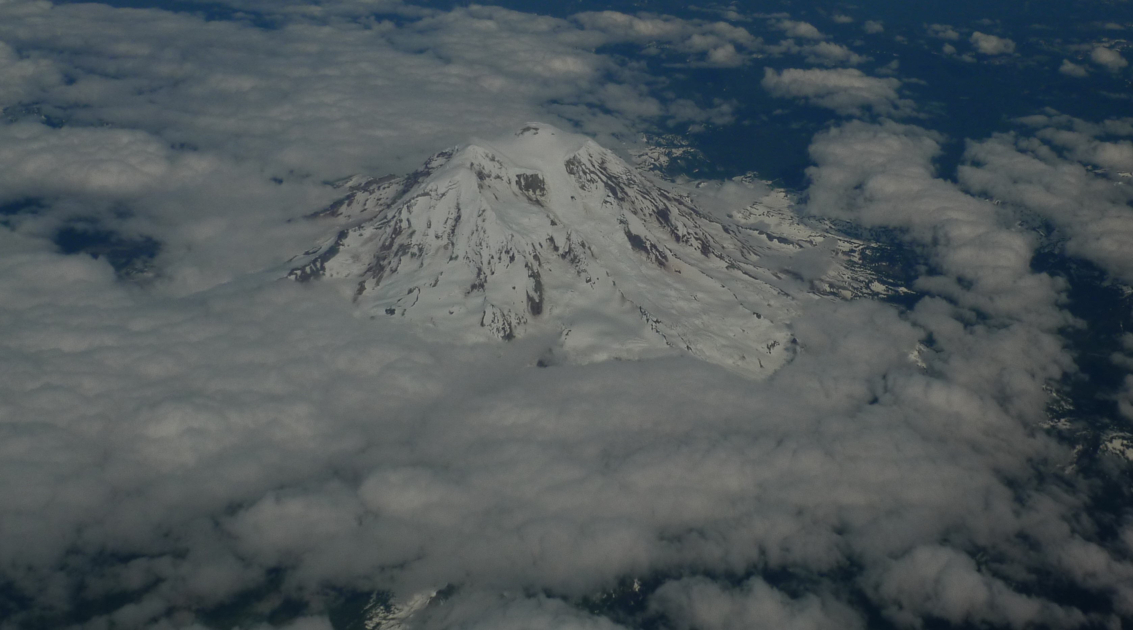
Visit Mt. Rainier National Park!

